Slide 1
Customer Clustering Analysis Summary
Exploratory Data Analysis | Feature Selection | K-Means Clustering | Outlier Detection | Data Quality Checks
Presented By Sudhanshu Raj
Email: sudhanshuraj8789@gmail.com
Source code: https://github.com/Raj87Sudhanshu/ProcDNA-Assignment.git

Slide 2
Q1: Clustering Model Logic & Results Summary
• Algorithm: K-Means clustering is used to segment customers based on selected features.
• Goal: Group similar customers to enable targeted strategies.
• Method:
- Applied K-Means with optimal clusters (k=5) determined using Elbow and Silhouette methods.
- Standardized data before clustering.
• Outcome: Each customer is assigned a cluster number.

Slide 3
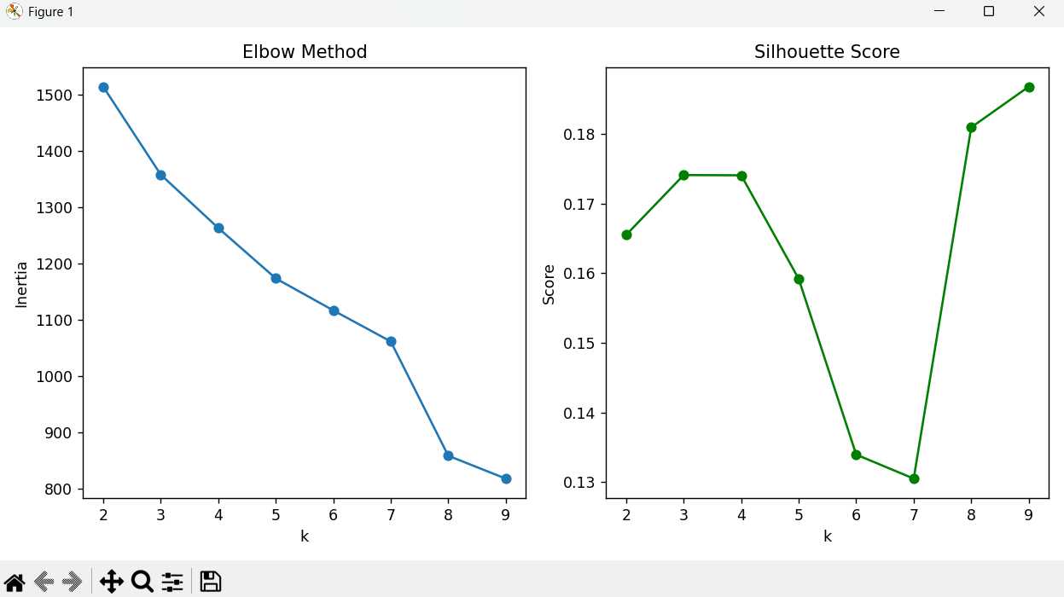

Slide 4
Q2: Feature Selection Approach
Approach: Selected categorical segment features, removed address/location columns.
Features Dropped:
- Street, City, Postal_Code: Non-informative for segmentation.
- Country, State_Code: Not relevant for clustering logic.
Reasoning:
These features are not useful attributes for clustering
Categorical features were encoded using Ordinal encoder.

Slide 5
Q3: Visualization of Clusters
Used PCA (Principal Component Analysis) to reduce dimensions to 2D.
Visualized clusters using scatter plots with different colors.
Clear separation observed among clusters in the reduced 2D space.

Slide 6
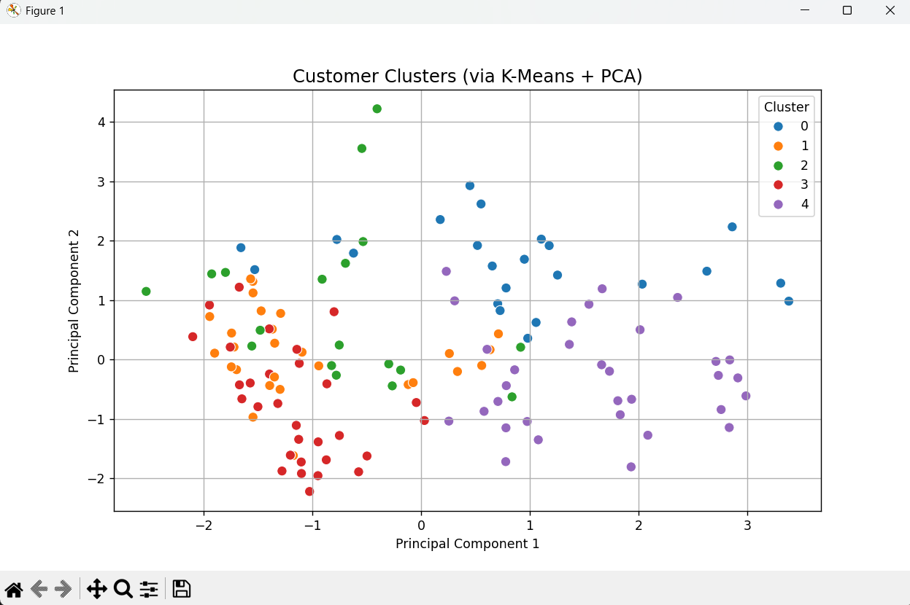

Slide 7
Q5: Data Quality Issues
• Issues Identified:
- 'None' and '-' used inconsistently to denote missing values.
- Some columns had mixed data types (e.g., strings and None).
• Resolution:
- Standardized missing values.
- Cleaned and encoded all categorical data uniformly.

Slide 8
Q6: Quality Checks for Solution
• Quality Checks Performed:
- Check for missing or malformed values post-cleaning.
- Verified encoding of categorical features.
- Used Silhouette Score to evaluate cluster cohesion.
- Manual inspection of extreme cluster values for anomalies.
- Visualized final cluster summary.

